Slide 1

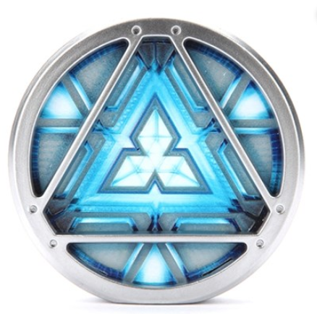
IronMan
Mood Light
신과 함께 조
신재형, 김주현, 양재혁

Slide 2
INDEX
INDEX
Goal Of Project
-
Circuit Diagram
-
Code
&
Git Open Source Utilization
-
Production Process Video
-
Q&A
-

Slide 3
Goal
GOAL
1. Product that I can put in my house.
2. Focus on the necessary function.
3. comfortable for user
4. Simple design

Slide 4
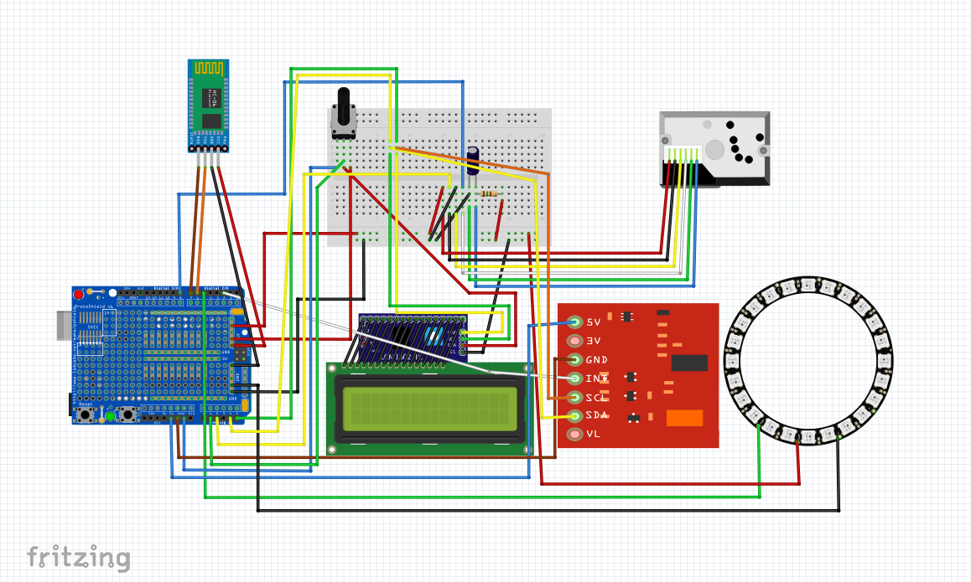
Circuit Diagram
IronMan MoodLight
SCHEMIC

Slide 5
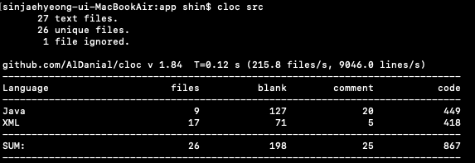
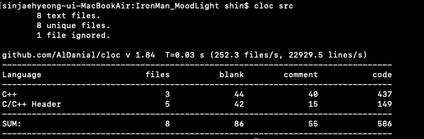
Overall architecture
IronMan MoodLight
Code &Git Open Source Utilization

Slide 6
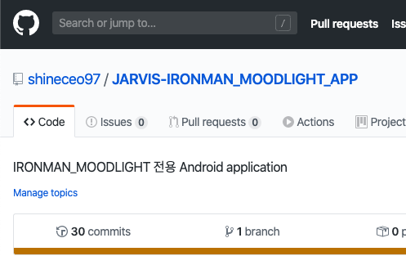
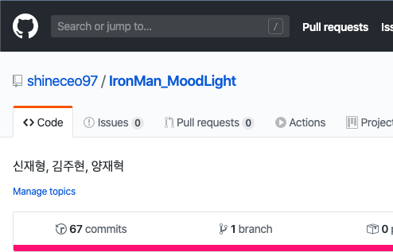
Overall architecture
IronMan MoodLight
Code &Git Open Source Utilization
GITHUB

Slide 7
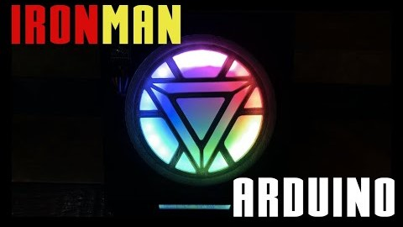
Overall architecture
IronMan MoodLight
Production Process Video
VIDEO

Slide 8
Q&A
신과 함께 조
신재형, 김주현, 양재혁

Slide 9
THANK YOU
신과 함께 조
신재형, 김주현, 양재혁

